Slide 1
C++ Data Types (so far)
int | 32 bits | -2,147,483,648 | 2,147,483,647
unsigned int | 32 bits | 0 | 4,294,967,295
char | 8 bits | -128 | 127
unsigned char | 8 bits | 0 | 255
short int | 16 bits | -32,768 | 32,767
unsigned short | 16 bits | 0 | 65,535
float | 32 bits | +/-3.4e +/- 38 | ~ 7 digits
 |  | +/-1.7e +/- 308 | ~ 15 digits

Slide 2
string data type
In C/ C++ there several ways to represent sequences of character data that have at least 2 consecutive elements
  use char arrays
    char word[12]
    this is an old style but still is useful
  use the built-in string class
    no subscripts to deal with
    lots of functions
    needs #include <string>

Slide 3
string functions
string is overloaded for the assignment operation
  string word = "hello";
size – number of characters in the string
  int len = word.size(); //len = 5
append – add more characters to the end of a string
  word.append(", world!"); //word now "hello, world!"
substring – copy out a sequence of characters from the string
  string ss = word.substring(8, 5); //ss contains "world"
Many more

Slide 4
bool data type (C++ only)
the bool data type in C++ has only two values – true and false
true and false are defined reserved words in C++
true and false may be directed assigned to and compared to variables of type bool
  bool op1 = false;
  if(op == true) …
bools may used as parameters, class members, local variables and global

Slide 5
Control Structures
Three basic ways control can flow through a program (and one odd one)
  sequence – one statement after another
  selection – execution of a statement of statements if some condition has been met
  repetition – repeating a statement(s) until some condition has been met
    some event occurred
    an exact count was reached
When more than one statement is controlled by any of the above it is called a compound statement
  compound statement is a group of statements within { }

Slide 6
Relational Operators and Expressions
Some control structures are controlled by relational expressions
Relational operators in C/C++ - <,>,<=,>=, == , !=
Relational operators evaluate to 0 if false, 1 if true in C / C++
  if (0) is always false
  if (1) is always true
Relational operators are always binary
  op1 == op2
  op1 >= op2
  op1 != op2

Slide 7
Logical (Boolean) Operators
Logical operators in C/C++ -
  || = OR
  && = AND
  ! = NOT
|| and && are binary
! is unary
  when used on a single operand it affects that lone operand
    ! op1 || op2
  when used on a parenthesized expression, it negates the entire expression
    !(op1 || op2)

Slide 8
Review Operator Precedence in C++
Function calls
! + - (unary)
* / %
+ -
< <= >= >
== !=
&&
||
=

Slide 9
Examples
x = 12; y = 4; z = 3; a = 5.1; c = 'Q'; flag = 0;
  x == y*z || z!=3
  x == y*z && z!=3
  x >=10 || a < 10.0 && y % 2 ==0
  !(x == 12)
  flag && 1
  !flag && 1
  (c == 'Q' || c == 'q') && x > 10

Slide 10
Comparing Character data - ascii code,
Value position the ascii is quite arbitrary – you just have to remember
Alphabet chars are in order from lower to higher (upper and lower case) but lower case letter are higher ('A'=65, 'a'=97)
'9' >= '0' is true ascii '9' = 57, ascii '0' = 48
'a' < 'e'
'B' < 'A'
'Z' == 'z'
'a' <= 'A'
'a' <= ch && ch <= 'z'

Slide 11
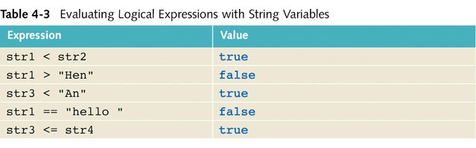
string Comparison Example
Suppose we have the following declarations:
  string str1 = "Hello";
  string str2 = "Hi";
  string str3 = "Air";
  string str4 = "Bill";

Slide 12
if statements
if ( condition )
statement ;
if ( condition )
{
statement;
statement;
....
}
if ( condition )
statement;
else
statement;
condition is a relational or boolean expression
if condition is true execute the statement following if (or block of statement)
if condition is false skip the statement(s)
in if (…) else statements if the condition is true execute the top statement otherwise execute the statement following else

Slide 13
Logical Assignment C vs C++
//old C style
#include <stdio.h>
#define TRUE 1
#define FALSE 0
void main(){
int letter, x, age, senior;
int found = FALSE;
char ch= 'B';
printf("Enter age:");
scanf("%d",&age);
senior = ( age >= 65);
if(senior)
printf("Discount applied.");
while (! found){
//do something...
if(x == 0)
found = TRUE;
}
//later
letter = ('A' <= ch && ch <= 'Z') ||
('a' <= ch && ch <='z');
}
//C++
#include <iostream>
using namespace std;
void main(){
int x=0, age;
bool found = false, letter, senior;
char ch= 'B';
cout << "Enter age:";
cin >> age;
senior = ( age >= 65);
if(senior)
printf("Discount applied.");
while (! found){
//do something...
if(x == 0)
found = true;
}
//later
letter = ('A' <= ch && ch <= 'Z') ||
('a' <= ch && ch <='z');
}

Slide 14
Complementing a Condition
"Hello, condition. You're looking well!"
Sometimes conditions make more sense reversed
A reversed condition is a called the complement of the condition
Non-compound conditions are easy to reverse
  just put ! in front of it - (x>y) becomes !(x>y)
  or change the operator - (x>y) becomes (x<=y)
if ( !isSummer( date ) )
charge = winterCharge( quantity );
else
charge = summerCharge( quantity );
if ( isSummer( date ) )
charge = summerCharge( quantity );
else
charge = winterCharge( quantity );

Slide 15
Truth Tables
Truth tables define what values operators should have under certain conditions
x | && | y
T | T | T
T | F | F
F | F | T
F | F | F
x | || | y
T | T | T
T | T | F
F | T | T
F | F | F
x | !x
T | F
F | T

Slide 16
DeMorgan's Theorem
For complementing conditions with && and ||
The complement of
  exp1 && exp2 → comp1 || comp2
the complement of
  exp1 || exp2 → comp1 && comp2
Example
age > 25 && status == 'S' --> age <= 25 || status != 'S'
age > 25 && ( status== 'S' || status == 'D') →
age <= 25 || ( status != 'S' && status != 'D')

Slide 17
How many statements controlled?
if(a >= 10) /* how many statements */
x = 0;
y = 1;
if(a >= 10); /* how many statements */
x = 0;
y = 1;
if a >= 10 /* how many statements */
x = 0;
y = 1;
if(a>=10) { /* how many statements */
x = 0;
y = 1;
}

Slide 18
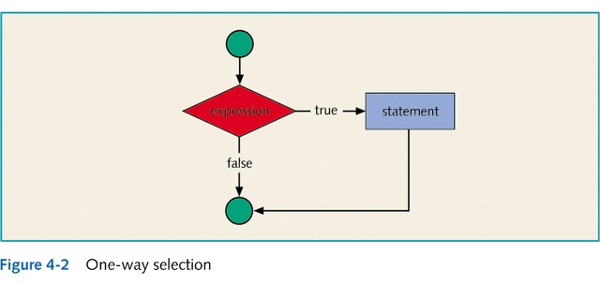
One-Way Selection

Slide 19
Two-Way (if…else) Selection
Two-way selection takes the form:
if(expression)
statement1
else
statement2
If the value of the expression is true, statement1 is executed otherwise statement2 is executed
statement1 and statement2 are any C++ statements
else is a reserved word

Slide 20
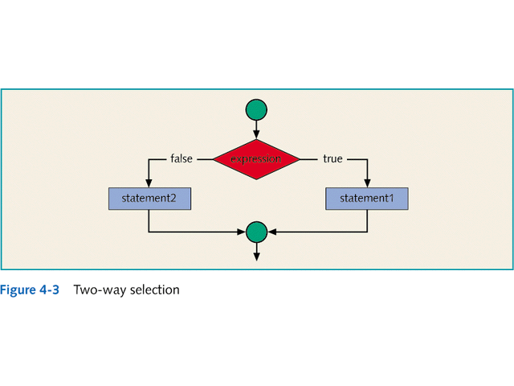
Two-Way Selection

Slide 21
Compound Statement
A compound statement (also called a block of statements) takes the form
{
statement1;
statement2;
.
.
.
statementn;
}
A compound statement is considered a single statement

Slide 22
Compound Statement Example
if(age > 18)
{
cout<<" Eligible to vote."<<endl;
cout<<" No longer a minor."<<endl;
}
else
{
cout<<"Not eligible to vote."<<endl;
cout<<"Still a minor."<<endl;
}

Slide 23
Nested if
When one control statement is within another, it is said to be nested
An else is associated with the most recent if that has not been paired with an else
For example:
if(score >= 90)
cout<<"The grade is A"<<endl;
else if(score >= 80)
cout<<"The grade is B"<<endl;
else
cout<<"The grade is F"<<endl;

Slide 24
switch Structures
In a switch structure, the expression is evaluated first
Next, the value of the expression is used to perform the corresponding action
The expression is usually an identifier
It is sometimes called the selector
The expression value can be only integral
Its value determines which statement is selected for execution
A particular case value should appear only once

Slide 25
switch Structures
One or more statements may follow a case label
Braces are not needed to turn multiple statements into a single compound statement
The break statement may or may not appear after each statement
The break statement has a special meaning and may or may not appear after each statement
switch, case, break, and default are reserved words

Slide 26
switch Statement Rules
When the value of the expression is matched against a case value, the statements execute until a break statement is found or the end of the switch structure is reached
If the value of the expression does not match any of the case values, the statements following the default label execute. If there is no default label, and if the value of the expression does not match any of the case values, the entire switch statement is skipped
A break statement causes an immediate exit from the switch structure

